Slide 1



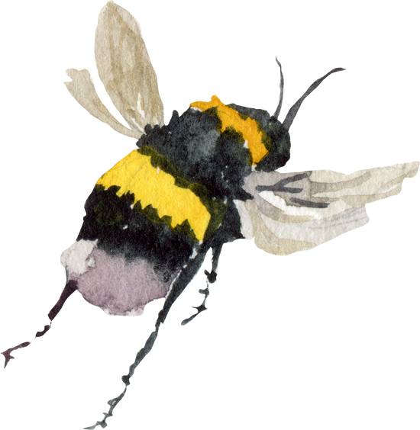


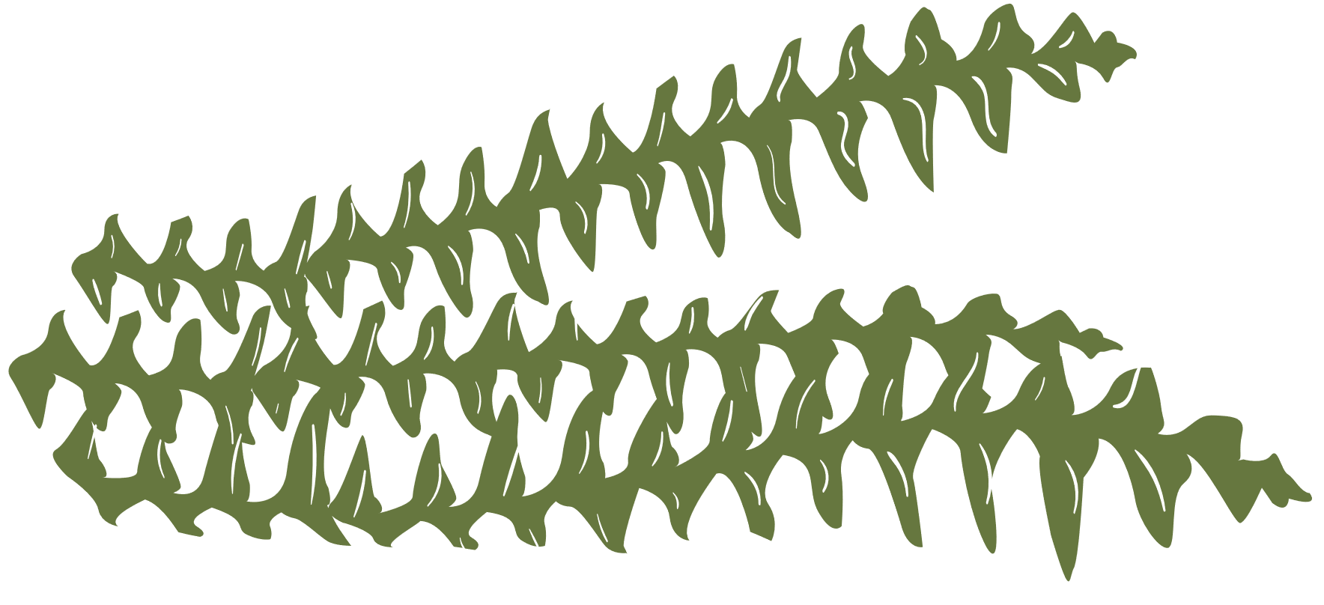
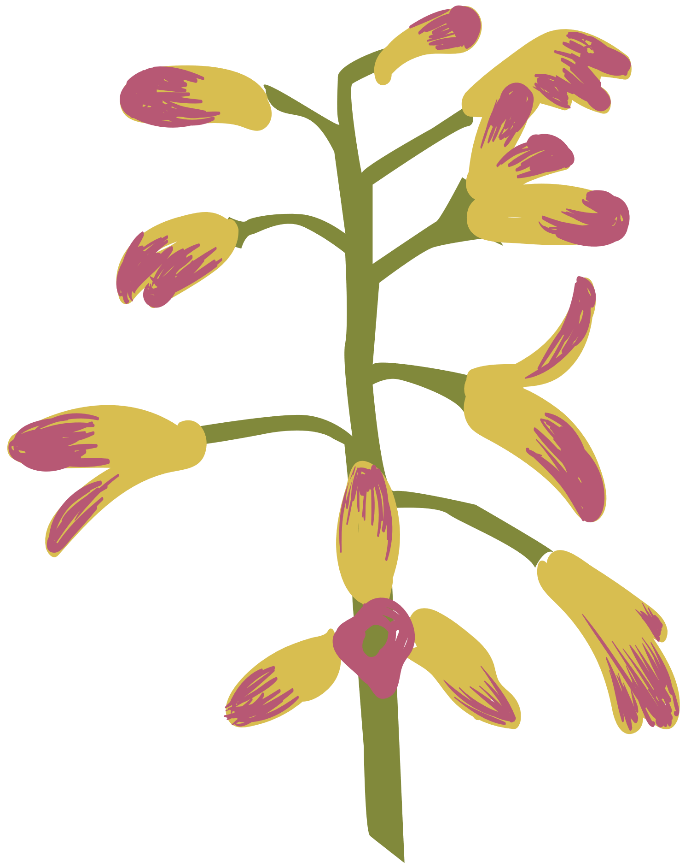


The Tree and Bee Corridor
Eastleigh Borough Council’s Local Area Committee
(BIFOHH) working in partnership with Bishopstoke, Fair Oak and Horton Heath Parish Councils
Helen Brown Treescapes

Slide 2

WELCOME TO THE PROJECT
  The Tree and Bee Corridor aims to connect existing areas of woodland and the biodiversity they contain by creating a patchwork of living stepping stones through the landscape
  This patchwork allows the movement, predominantly of insects, birds and mammals, between favourable areas of habitat by providing ‘service stations’ for food and shelter along the way
  The planting sites comprise road side verges to create a linear corridor; open spaces within residential areas, parks and cemeteries and green space in proposed development sites
  The ‘stepping stones’ can take different forms, varying from a stacked planter in a shopping area, trees growing along a roadside with an understorey of wildflowers, to edible tree gardens or tree gardens within residential areas

Slide 3
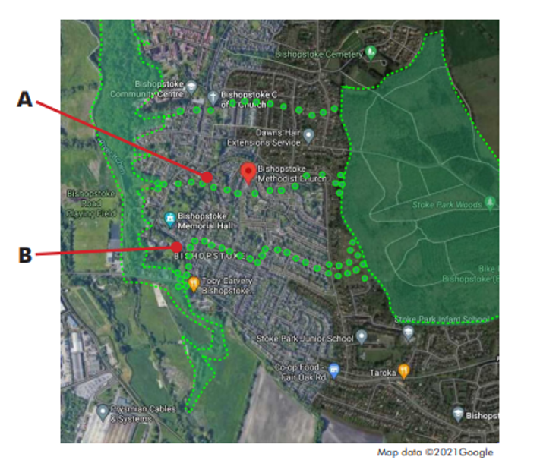

Map illustrating the corridor concept
A - The corridors will comprise a series of planting sites which will be opportunistic, occupying space where it is available. Examples include redundant green spaces in residential areas, allotments and parks. Collectively the corridors will form a network.
B – Existing Corridors in the landscape are also potential planting sites such as along footpaths, roads, cycle paths and rivers.

Slide 4
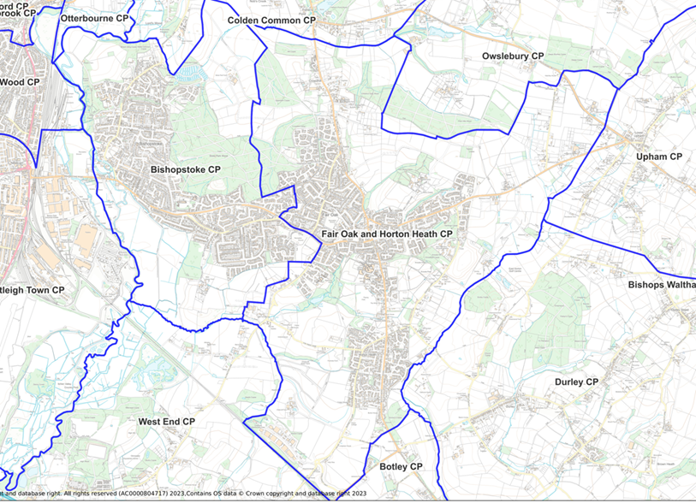
Currently, we have planting sites in Bishopstoke, Fair Oak and Horton Heath which we are increasing to extend the Corridor and develop it into a network

Slide 5
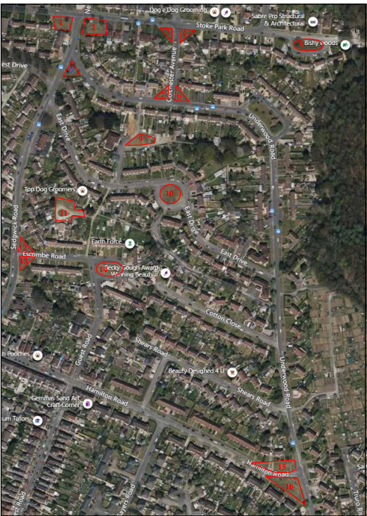
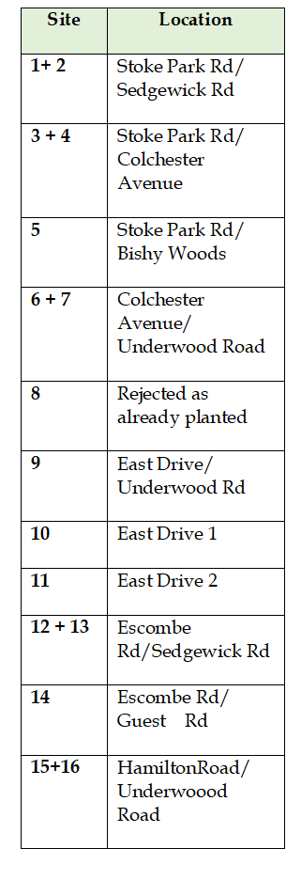
The sites we have already planted in Bishopstoke:
Stoke Park Woods

Slide 6
Expanding the Tree and Bee Corridor into the wider landscape to create a network
We are now identifying and planting sites on Council and Parish owned land within the Parishes of Fair Oak and Bishopstoke incorporating sites such as:
School grounds
Roundabouts
Allotments
Pocket woodlands
Community gardens within new housing developments with the use o funding from developers
Reinstating and bolstering existing hedgerows with native edible species
Mapping and incorporating veteran trees as biodiversity hotspots and sources of local seed
Promoting natural regeneration

Slide 7
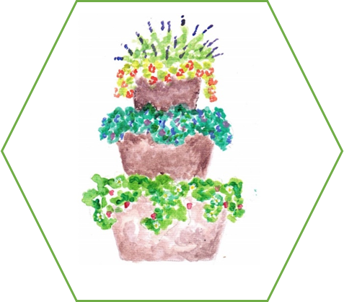
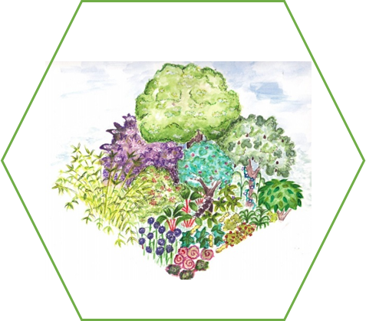
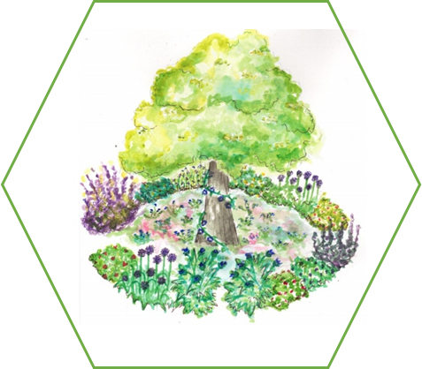
Here are examples of how the ‘stepping stones’ can be planted to create the
Tree and Bee Corridor
Tree with underplanting
of edibles or
pollinator plants
Planter with edible
pollinator
plants
A forest garden
system

Slide 8
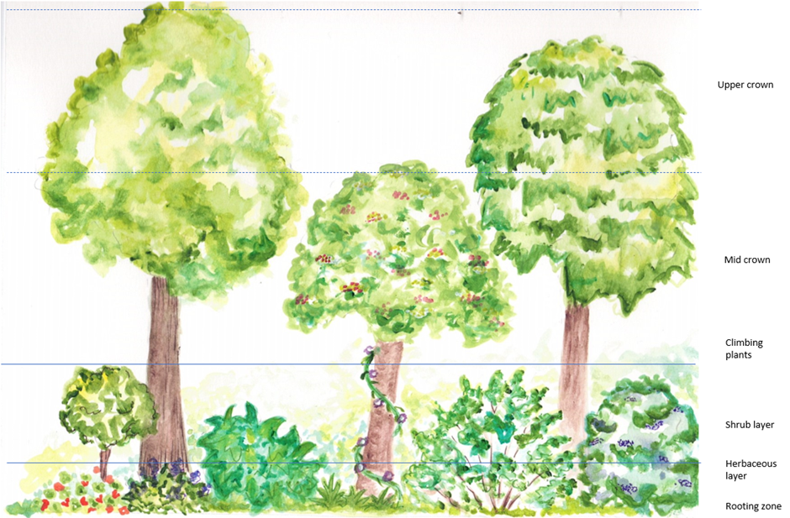
The forest garden, or tree garden has the same structure as our native woodland with an upper and lower crown, shrub and herbaceous layer, but we will plant trees which produce fruit and nuts such as hazel. Climbers bind the layers together.

Slide 9
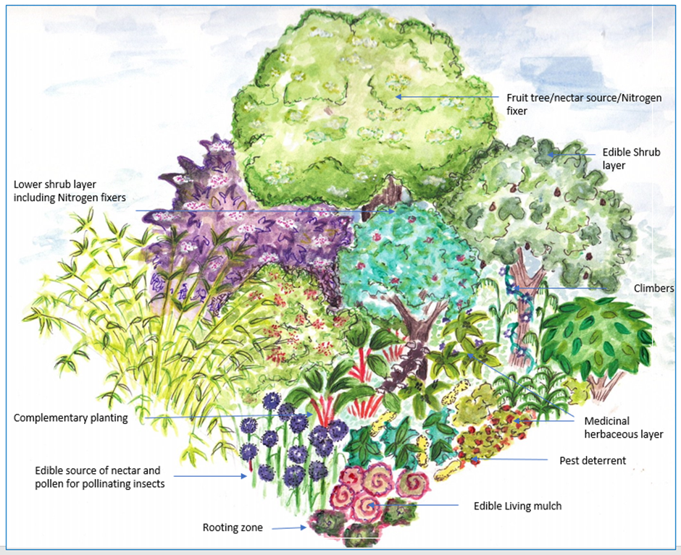
Examples of what we can grow in the Forest Garden
Upper/lower canopy
Apple
Asian pear
Cherry
Damson
June berry
Pear
Quince
Shrub layer
Cob nut
Elder
Hazel
Hibiscus
Tayberry
Black currant
Climbers
Hardy kiwi
Blue passion flower
Thornless bramble
Grape
Herbaceous layer
Globe artichoke
Herbs
Edible flowers
Salad
Rooting zone
Rooting veg
Artichoke
Garlic
Onion

Slide 10
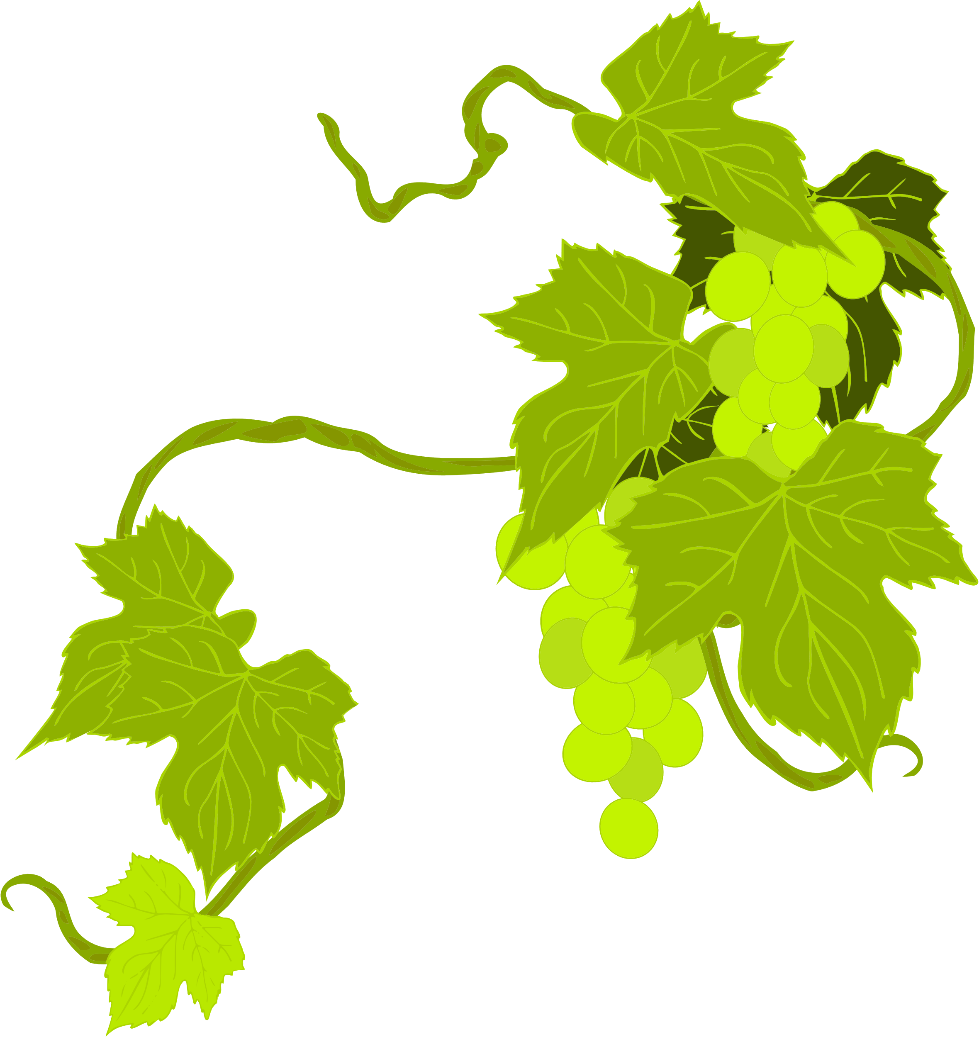
Below is a list of the potential trees, shrubs. herbs and edible flowers we could plant within a forest garden on your doorstep. This is for you and your community to choose what you would like to grow:
Quantities will depend on the size of the planting site, but you might be surprised how much we can fit into a forest garden!
Trees: Bay leaf, cooking and eating apple, crab apple, chestnut, cherry, damson, elder, hazel, June berry, pear, Victoria plum, quince
Shrubs: Blackcurrant, cobnut, black elder, gooseberry, honeyberry, logan berry, raspberry, red currant, tayberry
Plants: Herbs (chive, mint*, lemon balm*, lavender, marjoram, thyme, purple sage), bronze fennel
Vegetables: Asparagus, courgette, green beans, broccoli, cauliflower, Kale, marrow, root veg such as Beetroot, carrots, globe artichoke and parsnip, pumpkin, peas, salads, spinach
Edible FLOWERS: Borage, cornflower, courgette, daisy, freesia, elder, Forget-me-not, Hibiscus, Hollyhock, lavender, marigold, mint, primrose, nasturtium, pea, pinks (Dianthus, carnation), rose, runner bean, sunflower, viola
Climbers: Chocolate vine, kiwi, grape, Passion flower, runner bean, thornless bramble
* Need to be contained to prevent dominance over other plants

Slide 11
Plant screening
The forest garden is a finely tuned system of plants which are carefully selected for their compatibility.
Plants are also screened for their invasive potential and for this reason some are avoided such as hop and some species of bamboo. We therefore ask that you don’t put plants from your garden into the forest gardens without checking with us first.
Plant risk assessment
Some plants may have poisonous parts such as fox glove and honey suckle and for this reason, they will not be included in the planting mix.

Slide 12


How will the Tree and Bee Corridor add value to the local landscape?
  Tree planting helps climatic regulation - providing shade in summer, intercepting rainfall and reducing run off, reducing flood risk
  Biodiversity - more habitat niches, polinator plants and no chemicals
  Improves social cohesion and deeper community relations through a shared task
  Calms eco-anxiety through positive action
  Addresses food insecurity
  Research shows that contact with and emersion in nature improves our mental health
t

Slide 13
Questions and Answers
What are the benefits to local residents?
Residents living close to the forest or tree gardens will benefit from locally grown, organic food and will have the opportunity to get involved with the management of the gardens, bringing them closer to nature and immersing them in the physical health and psychological benefits that are associated with gardening.
What are your views?
As a resident living within easy reach of a forest garden planting site, we would love to hear your views to make sure the forest gardens are tailored to your needs. For example, would you like to include cooking apples in the garden, or quince? Would you like to have both black and red currant bushes available, tayberry or loganberry?
We will provide information and guidance on how to use the produce from the garden – such as sharing delicious recipes and learning techniques of food preparation like pickling and fermenting! You may also have some recipes and tips you would also like to share.

Slide 14




Are you interested in helping to look after the gardens and enjoy the bounty they will provide?
We are looking for volunteers to help with planting, watering and a spot of weeding in return for picking fruit, herbs and other edibles to enjoy yourself. You might also be interested in planting a mini forest garden in your own front garden?
Alternatively, you may like to adopt a tree for yourself or on behalf of someone else?
We would like to invite you to adopt a tree, either for yourself, as a gift or in memory of someone else. There will be no cost to you but, in return, we would ask you to look after the tree and take care of it during times of drought for example, to make sure it is appropriately watered and remains in good condition. We are here to help you and will provide expert advice if any of the forest garden plants need attention or replacing.

Slide 15






We would love to hear your views to ensure the
gardens are designed for you and your community
For more information or to get involved,
please email Becky:
treeandbee@eastleigh.gov.uk

